Slide 1

Department of Computer Engineering
Sequential Logic Design – Registers
1

Slide 2
Points covered
Department of Computer Engineering
Introduction
Types of registers
2

Slide 3
Department Vision & Mission
Department of Computer Engineering
Vision
Achieve academic excellence through education in computing, to create intellectual manpower to explore professional, higher educational and social opportunities.
Mission
To impart learning by educating students with conceptual knowledge and hands on practices using modern tools, FOSS technologies and competency skills there by igniting the young minds for innovative thinking, professional expertise and research.

Slide 4
Registers
Registers hold larger quantities of data than individual flip-flops.
There are many different kinds of registers.
A register is an extension of a flip-flop that can store multiple bits.
Registers are commonly used as temporary storage in a processor.

Slide 5
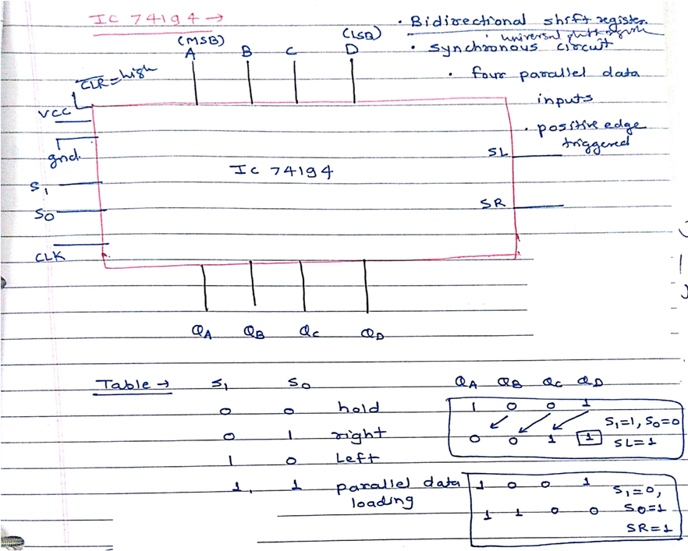

Slide 6
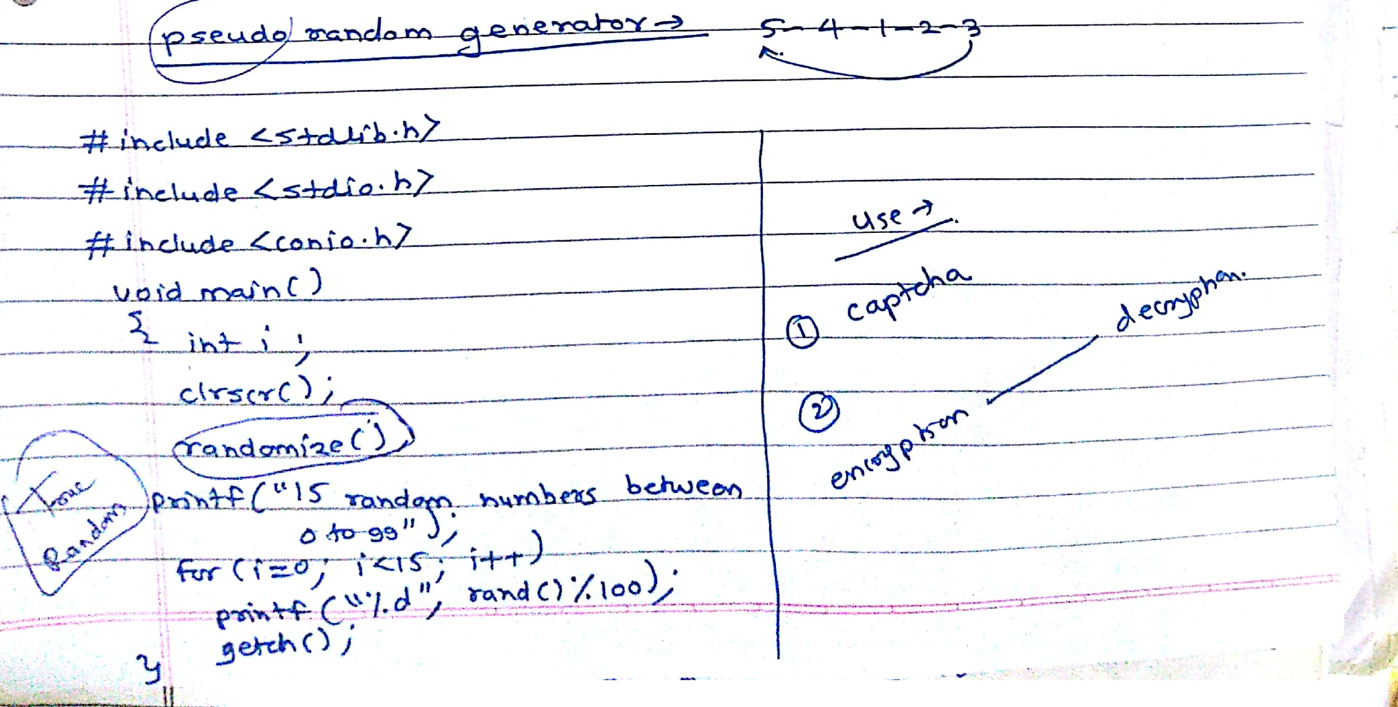

Slide 7
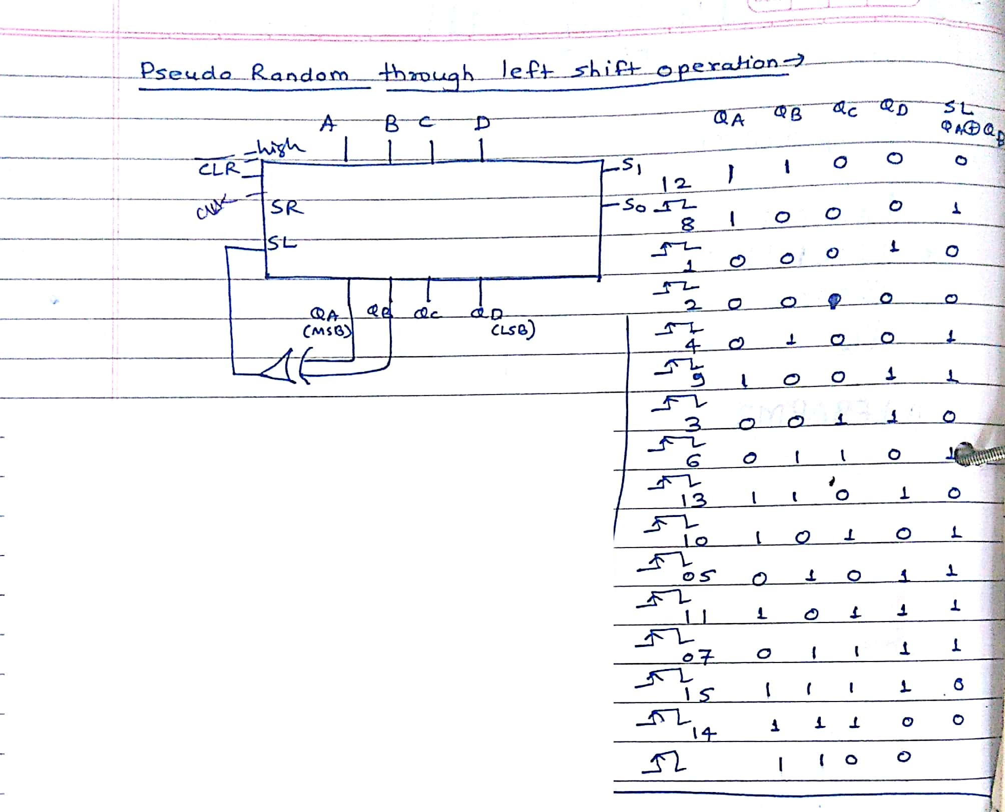

Slide 8
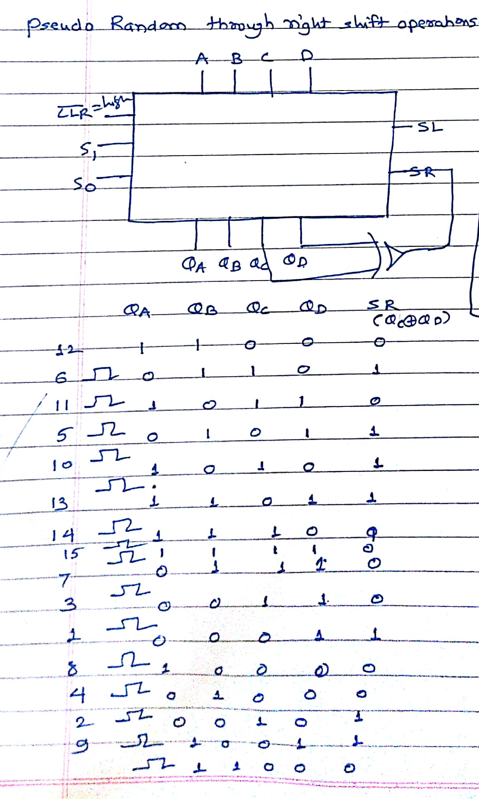

Slide 9
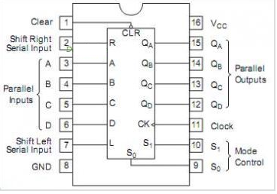

Slide 10
Types of Registers
Buffer Register
Shift Register
Serial In Serial Out (SISO)
Serial In Parallel Out (SIPO)
Parallel In Serial Out (PISO)
Parallel In Parallel Out (PIPO)
Bidirectional Shift Register
Universal Shift Register

Slide 11
Buffer Register
Input
Input
Input
D Q
Q
D Q
Q
D Q
Q
Output
Output
Output

Slide 12
Shift Registers
SISO: Serial In, Serial Out
SIPO: Serial In, Parallel Out
PISO: Parallel In, Serial Out
PIPO: Parallel In, Parallel Out
10110
10110
10110
10110
10110
10110
10110
10110

Slide 13
Registers 1.13
Shift Register Construction
Shift registers are comprised of D Flip-Flops that share a common clock input.
D Q
Q
D Q
Q
D Q
Q

Slide 14
Registers 1.14
SISO Flip-Flop Shift Register
10110
10110
a Serial In Serial Out shift register has a single input and a single output
Input
D Q
Q
D Q
Q
D Q
Q
Output

Slide 15
Registers 1.15
SIPO Flip-Flop Shift Register
A Serial In Parallel Out shift register has a single input and access to all outputs
Output
Output
Output
Input
D Q
Q
D Q
Q
D Q
Q
10110
10110

Slide 16
Registers 1.16
PISO Flip-Flop Shift Register
A Parallel In Serial Out shift register requires additional gates, and the parallel input must revert to logic low for serial output.
Input
Input
Input
Output
D Q
Q
D Q
Q
D Q
Q
10110
10110

Slide 17
Registers 1.17
PIPO Flip-Flop Shift Register
A Parallel In Parallel Out register has the simplest configuration. It represents a memory device.
10110
Input
Input
Input
D Q
Q
D Q
Q
D Q
Q
10110
Output
Output
Output

Slide 18
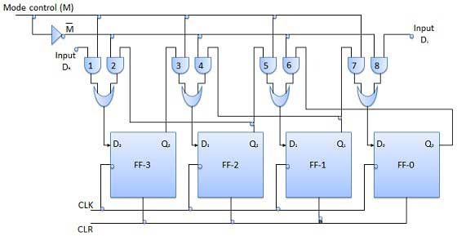
Bidirectional Shift Register

Slide 19
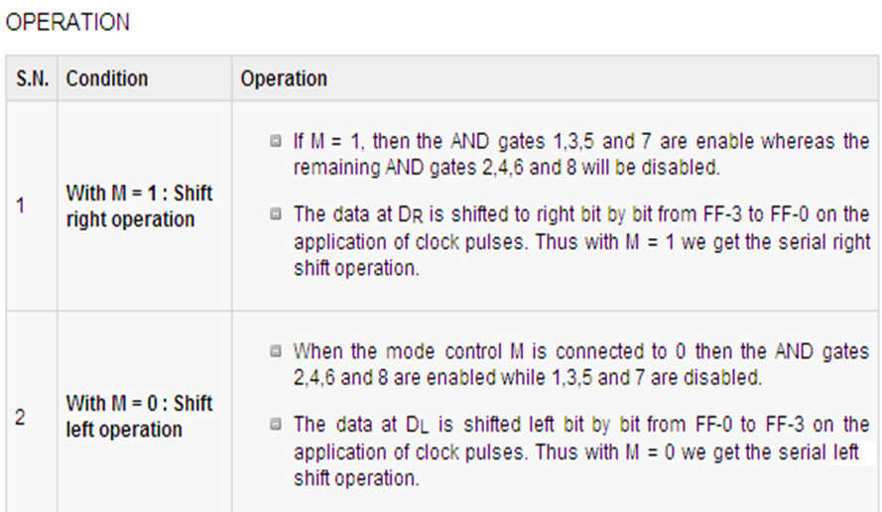
Bidirectional Shift Register

Slide 20
Registers 1.20
Universal Shift Register
If the register has both shifts (right shift and left shift) and parallel load capabilities, it is referred to as universal shift register.

Slide 21
Registers 1.21
Shift Register Applications
Temporary data storage.
Bit manipulation.
Serial to parallel convertor.
Parallel to serial convertor.
Computer and Data Communications.
Serial and Parallel Communications.
Multi-bit number storage.
Sequence generator.
Sequence Detector.
Logical operations.
Notes:
21

Slide 22
Department of Computer Engineering
Thank you

